Slide 1
Types Of Hosting
Presented by Nyein Nyein Htwe.

Slide 2
Types Of Hosting
VPS hosting
Shared hosting
Cloud hosting
Dedicated hosting

Slide 3
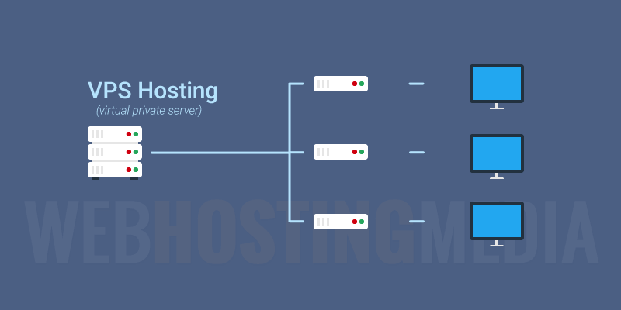
VPS Hosting
VPS hosting, or Virtual Private Server hosting, is a type of web hosting where a physical server is divided into multiple virtual servers, each running its own operating system and hosting its own set of websites or applications.
Each VPS is allocated a certain amount of resources, such as CPU, RAM, and storage, which are dedicated to that particular virtual server. This means that VPS hosting offers greater control, flexibility, and scalability compared to shared hosting, while also being more affordable than dedicated hosting.
VPS hosting is particularly useful for businesses or individuals who require more resources and control than shared hosting, but do not need the full power of a dedicated server. It is commonly used for hosting websites, running web applications, hosting game servers, or as a remote desktop for remote access to applications and files.

Slide 4
Advantages of VPS Hosting
Disadvantages of VPS Hosting
Cost-effective: VPS hosting is more affordable than dedicated hosting, making it a great option for businesses and individuals who need more resources than shared hosting provides, but cannot afford a dedicated server.
Greater control: VPS hosting provides more control over the server than shared hosting. Users have root access, allowing them to install and configure software as needed.
Improved performance: VPS hosting provides better performance than shared hosting because resources are allocated to individual virtual servers, rather than shared among multiple websites.
Security: VPS hosting provides greater security than shared hosting, as each virtual server is isolated from others, and users have more control over the server's security configuration.
Technical knowledge required: VPS hosting requires technical knowledge to set up and manage, as users have greater control over the server's configuration.
Limited resources: VPS hosting provides more resources than shared hosting, but it is still limited by the physical server's resources.
Potential for downtime: VPS hosting can experience downtime if the physical server experiences hardware or software issues, affecting all virtual servers on that physical server.

Slide 5
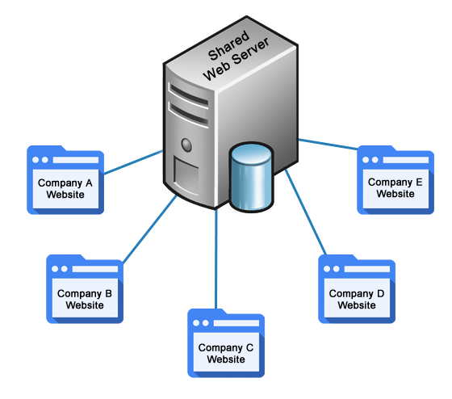
Shared Hosting
Shared hosting is a type of web hosting service where multiple websites are hosted on a single physical server and share its resources, such as CPU, RAM, and disk space. This means that the cost of hosting is divided among the different website owners, making it an affordable option for small businesses and individuals who want to establish an online presence.
Shared hosting providers typically offer easy-to-use control panels and a range of tools and features to make it easy for website owners to manage their websites. It is also a good option for websites with low to moderate traffic and those that don't require a lot of resources, such as small blogs and personal websites.

Slide 6
Low cost:Shared hosting is nothing but sharing a host server with another user. If a server is shared, then he/she can easily make a profit. They can also provide some cheaper services. The great profit and advantage of shared hosting is cost-effectiveness. This is done at a low cost. The web technology industry is the most growing industry.
Advantages of Shared Hosting
Disadvantages of Shared Hosting
System crashes: As I explained earlier, shared hosting is all about sharing the host server for many websites. When the server is loaded with more number of websites, then the traffic gets increased and the process of searching will get slower. Finally, the system gets crashed and get collapsed
Performance problem: performance is a very big issue. The components in the shared hosting web servers are shared. So ultimately the components are not evenly distributed. So the performance will get reduced based on the websites in the server.
Security: Security is most important in web hosting, but in shared hosting, it is very less. It provides lots and lots of services, but with no warranty. By this, hackers can easily hack your site. You may not know for a long time like what is happening? So try to avoid these types of problem and get escape from threats.
.

Slide 7
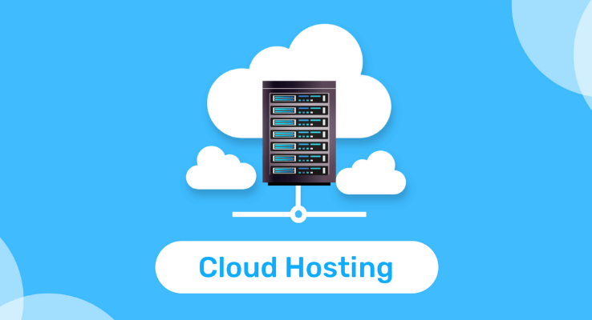
Cloud Hosting
Cloud hosting is a type of web hosting service where website files are stored on multiple virtual servers that are interconnected to form a cloud infrastructure. Cloud hosting allows for greater scalability, flexibility, and reliability compared to traditional hosting options.
With cloud hosting, website owners can easily scale up or down their resources (such as CPU, RAM, and storage) depending on their website traffic and usage.
Cloud hosting is popular among businesses and organizations that require high levels of reliability, security, and scalability, such as e-commerce websites, large enterprises, and startups.

Slide 8
Advantages of Cloud Hosting
Security: Cloud hosting can be vulnerable to security breaches if not properly configured and managed.
Limited Control: With cloud hosting, you have limited control over the underlying hardware and infrastructure, which may be a disadvantage for some users.
Performance: Cloud hosting can be slower than traditional hosting solutions since resources are shared among multiple virtual servers.
Disadvantages of Cloud Hosting
Scalability: Cloud hosting allows you to quickly and easily scale your resources up or down based on your needs, making it a very flexible hosting solution.
High Availability: With cloud hosting, your website or application is hosted on a network of servers, which means that if one server goes down, your website will automatically switch to another server, ensuring high availability and uptime.
Cost-effective: Cloud hosting is generally more cost-effective than traditional hosting solutions since you only pay for the resources you use.
Automatic Backups: Most cloud hosting providers offer automatic backups, ensuring that your data is safe and secure.
Disaster Recovery: Cloud hosting providers often offer disaster recovery options that allow you to quickly and easily recover your data in the event of a disaster.

Slide 9
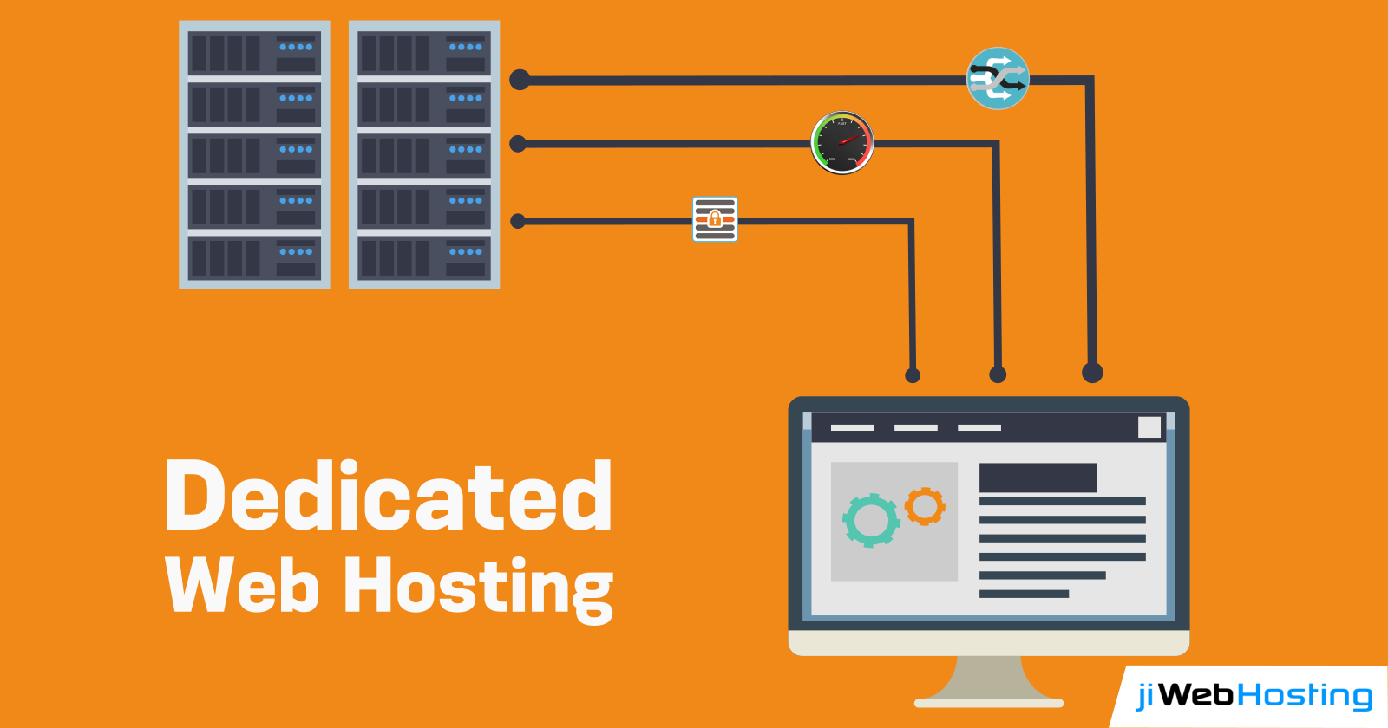
Dedicated Hosting
Dedicated hosting refers to a hosting service in which an entire physical server is dedicated to a single user or client. This means that the user has complete control over the server, including the choice of hardware and software configurations, as well as the ability to customize the server according to their specific needs.
Dedicated hosting is typically used by businesses or individuals who require high levels of performance, security, and reliability. It is also well-suited for websites or applications that receive high levels of traffic or require large amounts of storage or processing power.

Slide 10
Advantages of Dedicated Hosting
Disadvantages of Dedicated Hosting
Cost: Dedicated hosting is generally more expensive than other hosting options, as users are renting an entire physical server for their exclusive use.
Technical Expertise: Dedicated hosting requires a higher level of technical expertise to manage and maintain the server, which may not be feasible for all users.
Maintenance: Users are responsible for maintaining and updating the server, which can be time-consuming and require significant effort.
High Performance: Dedicated hosting provides high performance, as the entire server is allocated to a single user or client. This ensures that resources are not shared with other users, which can impact website or application performance.
Reliability: Dedicated hosting offers high reliability, as users have complete control over the server and can customize it according to their specific needs. This can lead to better uptime and improved website or application availability.
Security: Dedicated hosting is more secure than other hosting options, as users have complete control over the server and can implement customized security measures to protect their data and applications.
Scalability: Dedicated hosting can be easily scaled up or down depending on the needs of the user, which makes it a good option for businesses or individuals who expect their resource usage to fluctuate over time.

Slide 11
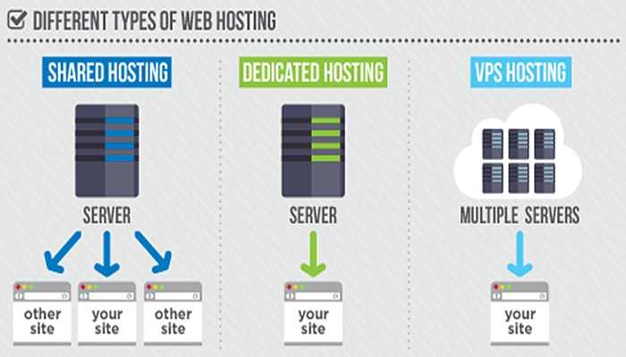

Slide 12
Thanks for your attention.
Any Question?

